Slide 1


Introduction to Emotional Manipulation
Emotional manipulation involves understanding and influencing others' emotions with intentionality. It's a powerful tool that can be used for both positive and negative purposes, making it crucial to understand its dynamics.
PK

Slide 2
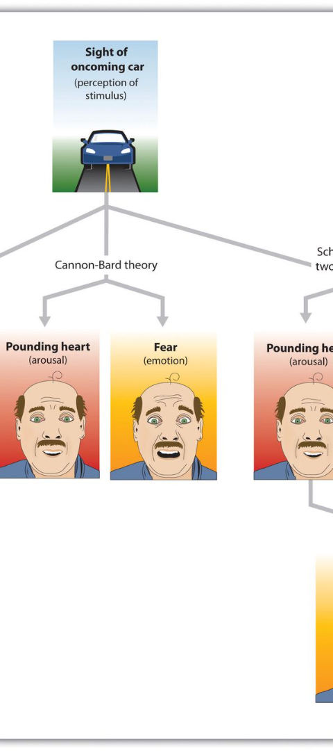
Understanding Emotional Influence
1
Empathy and Persuasion
2
Body Language and Tone
Recognize the emotions of others and use them to influence positive outcomes in various situations.
Maintain awareness of non-verbal signals to better understand and impact the emotions of others.
3
Emotional Intelligence
Develop the ability to perceive and manage emotions in oneself and others to achieve desired results.

Slide 3



Strategies for Emotional Detachment
Self-Reflection
Stress Management
Boundaries Setting
Understand personal emotional triggers and practice detachment in challenging circumstances.
Utilize stress-relief techniques to prevent being overwhelmed by emotions in difficult situations.
Establish clear boundaries to prevent others' emotions from negatively affecting personal well-being.

Slide 4

Leveraging Emotions for Desired Outcomes
1
Understanding Target Audience
Identify the emotional triggers and reactions of the target audience to tailor strategies accordingly.
2
Emotional Storytelling
Create narratives that evoke certain emotions to influence perceptions and decisions.
3
Positive Reinforcement
Reward and reinforce desired behaviors through positive emotional associations.

Slide 5
Conclusion and Key Takeaways
Ethical Considerations
Impact on Relationships
Continuous Learning
Understand the ethical implications of emotional manipulation and use it responsibly.
Recognize the impact this practice can have on personal and professional relationships.
Commit to ongoing education regarding
emotional intelligence and ethical
influence methods.

